Slide 1




IBM SKILLS BUILD JULY INTERNSHIP PROGRAM
SDG-
ZERO HUNGER
TEAM - FoneD

Slide 2
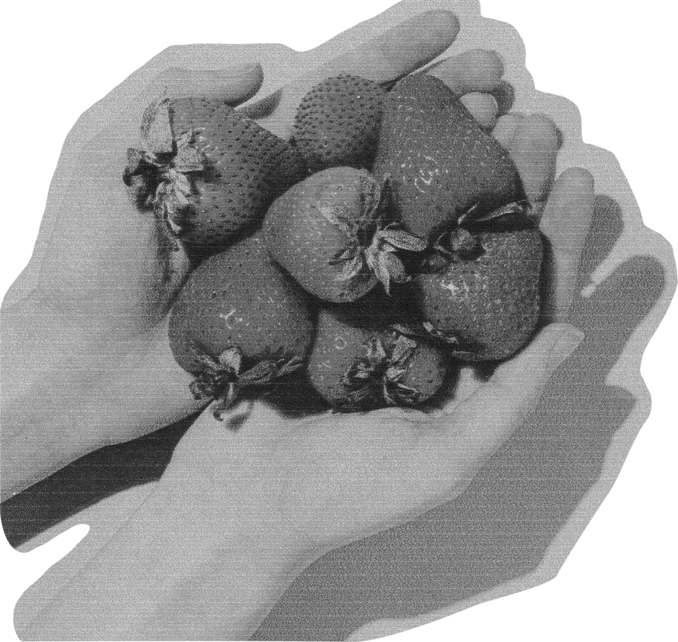
OUR TEAM
Rachit Agarwal
Lakshya Jindal
Prerna Sharma
Pranav Singhal
Tanmye Gorain

Slide 3



TABLE OF CONTENTS
01.
02.
Why we choose this project?🤔
Introduction
03.
04.
Aim Of Project
Features
05.
06.
Technologies
Site Map 🗺

Slide 4



INTRODUCTION TO
ZERO HUNGER

Slide 5



ZERO HUNGER -A MAJOR CRISES
Zero Hunger is indeed a major crisis on a global scale. Despite significant progress, hunger and malnutrition continue to affect millions of people worldwide. According to the United Nations, nearly 690 million people are undernourished, and the COVID-19 pandemic has exacerbated the situation, pushing millions more into food insecurity.

Slide 6



Definition of World Hunger
Addressing this crisis requires a multifaceted approach, including improving food production systems, ensuring equitable access to nutritious food, and promoting sustainable agricultural practices.
CAMPAIGN
OVERVIEW
Scope of the Issue
By working together, we can strive to achieve Zero Hunger and create a world where everyone has the opportunity to lead healthy and productive lives.

Slide 7

WHY WE CHOOSE THIS PROJECT?🤔

Slide 8


CAUSES OF WORLD HUNGER
Poverty
Conflict and War
Many people lack the financial resources to buy sufficient and nutritious food
Wars disrupt food production and distribution, leading to shortages
Climate Change
Inadequate Infrastructure
Extreme weather events, such as droughts and floods, destroy crops and livelihoods
Poor infrastructure hinders food storage, transportation, and market access

Slide 9
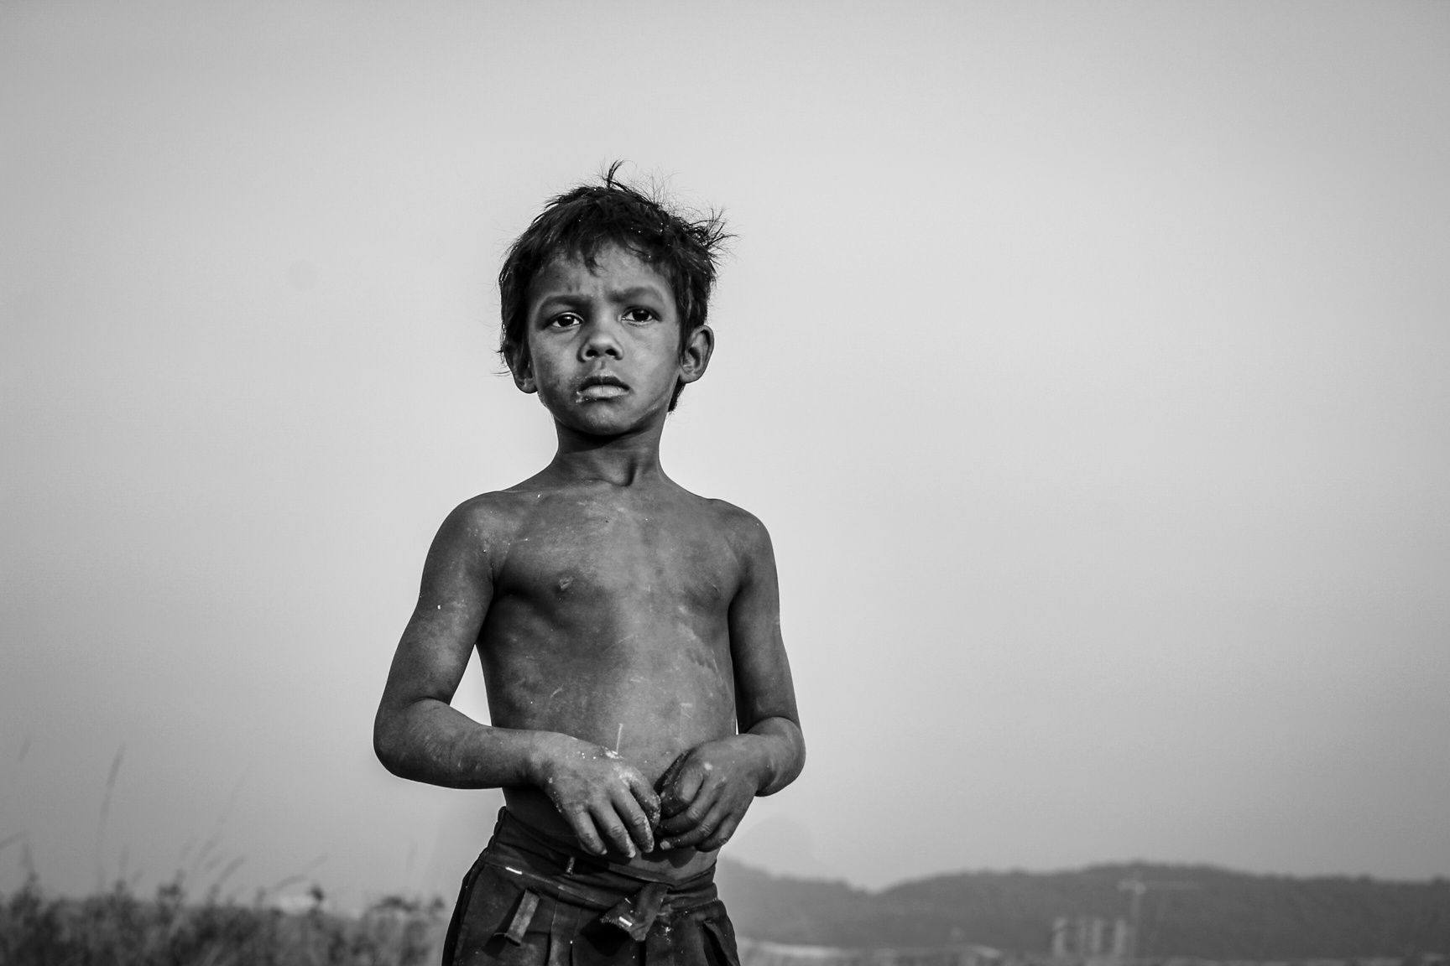
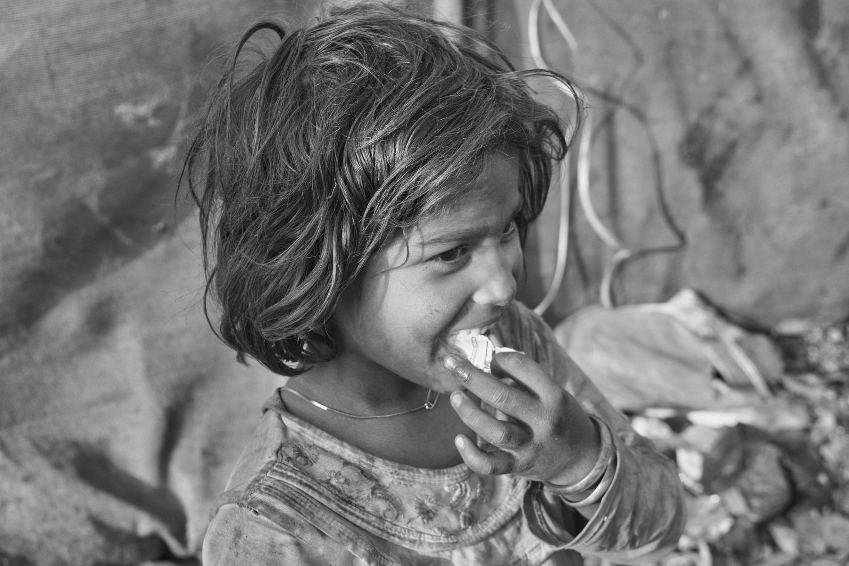


GALLERY

Slide 10



CONSEQUENCES OF WORLD HUNGER
Health Impacts
Social Impacts
Economic Impacts
Malnutrition weakens immunity and causes stunted growth.
Chronic hunger leads to developmental delays.
Hunger causes social unrest.
Affects children’s education and concentration.
Reduces workforce productivity.
Increases healthcare costs.

Slide 11




AIM
OF
PROJECT

Slide 12
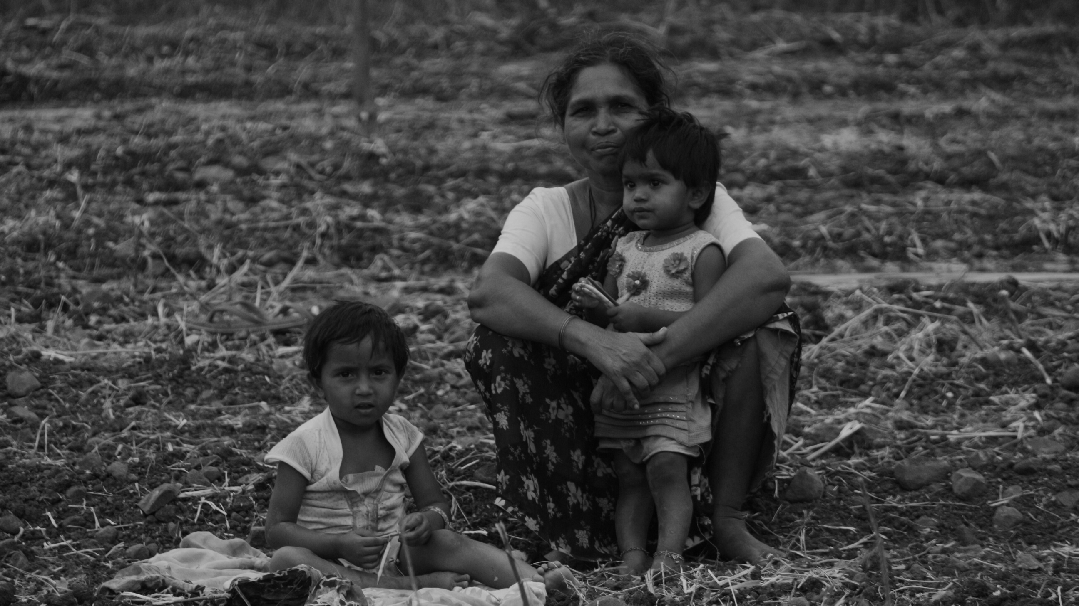
FOOD AID AND ASSISTANCE
Providing immediate relief and long-term support to food-insecure populations through distribution programs, nutritional education, and resource allocation.

Slide 13


THROUGH THE YEAR...
Ongoing initiatives and programs aimed at reducing hunger, involving governments, NGOs, and communities working together.
CONTINUOUS EFFORTS
EVOLVING STRATEGIES
Adapting approaches based on new research, data, and feedback to improve the effectiveness of hunger alleviation efforts.
Responding to emerging issues such as climate change, economic instability, and pandemics that impact food security.
GLOBAL CHALLENGES
utilizing advancements in AI, data analytics, and satellite imagery to predict food shortages, optimize resource distribution, and enhance agricultural practices.
LEVERAGING TECHNOLOGY

Slide 14


A picture is worth a thousand words

Slide 15

EVERY CONTRIBUTION MAKES A DIFFERENCE IN THE FIGHT AGAINST HUNGER, LEADING TO HEALTHIER, MORE PROSPEROUS COMMUNITIES WORLDWIDE.
Donate For The Cause

Slide 16

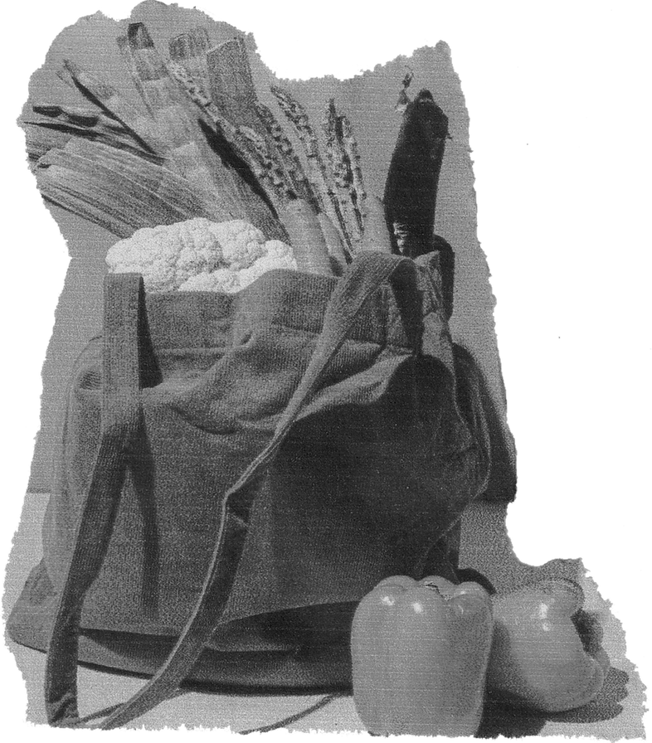
FEATURES
Donate
Spreading Awareness
Volunteeering
Community

Slide 17






TECHNOLOGIES

Slide 18
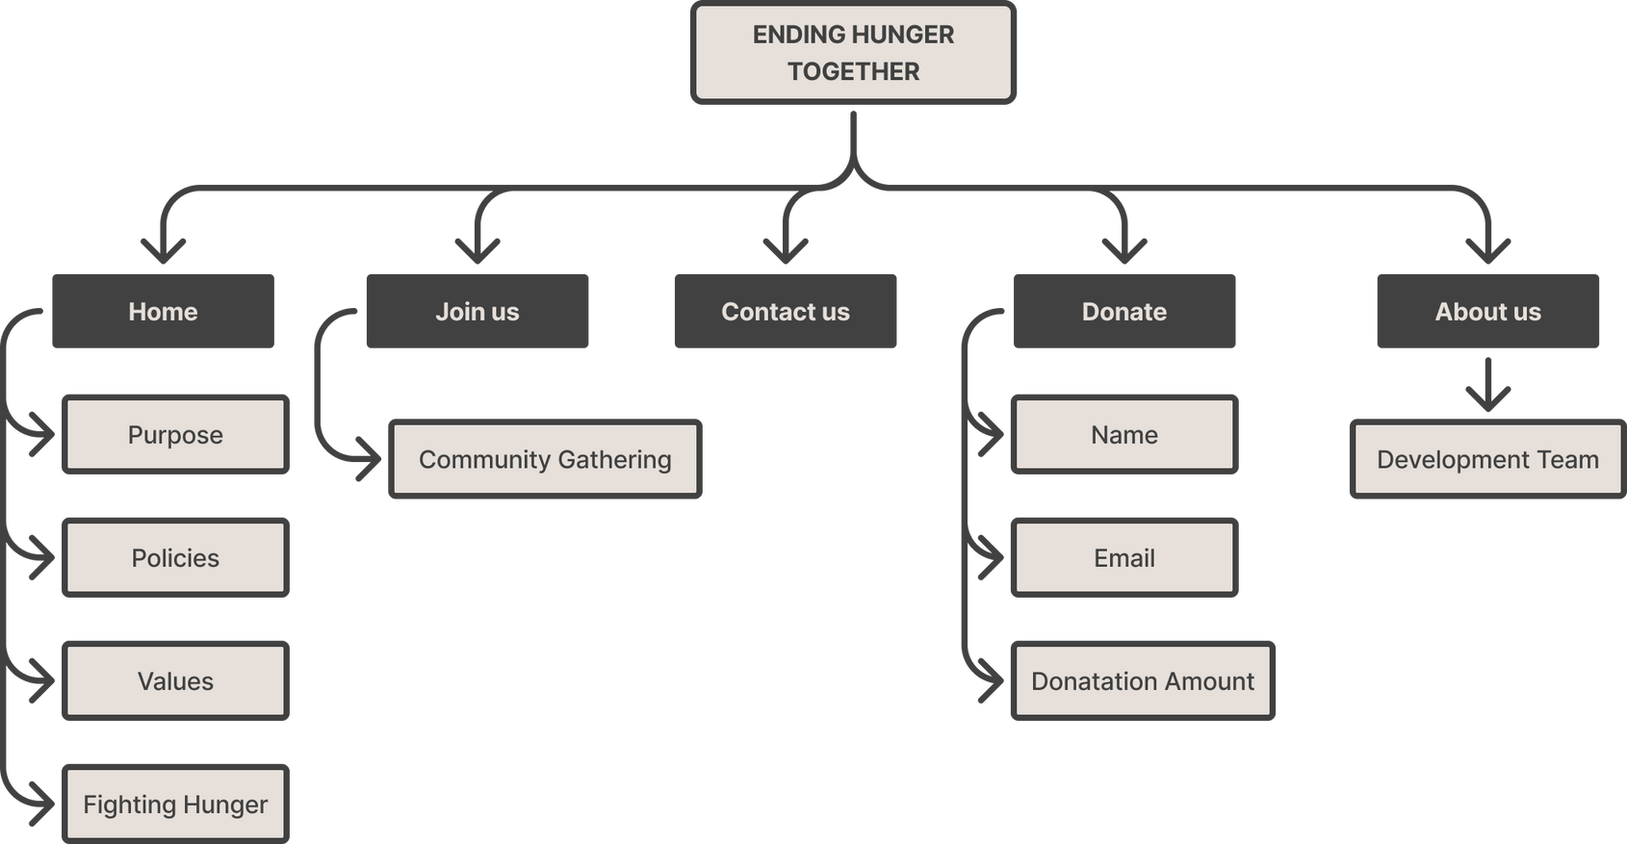
SITE MAP

Slide 19
VISIT OURSITE
ENDING HUNGER TOGETHER
HTTPS://CLOUD-OBJECT-STORAGE-COS-STATIC-WEB-HOSTING-WMG.S3.JP-TOK.CLOUD-OBJECT-STORAGE.APPDOMAIN.CLOUD/INDEX.HTMLAGRAPH TEXT

Slide 20
THANK YOU

